Slide 1

Days of our Life
Ceremonies and events that fill up a the daily routine of a scrum team member

Slide 2
Ceremonies, lots of them.
Basic Ceremonies of a Sprint*:
Sprint Planning--Figure out what you are going to do in the next sprint, who’s available, roadblocks, figure out workload.
Stand-Up (Daily 15 minutes)—What’s going on now, everyone must contribute, “walking the wall”.
Collaboration Time—Every day for about half the time (technically not a ceremony, but a big part of one’s day)
Story Times—Go over work backlog, work together to understand work ahead and create “stories” (aka a demonstrable unit of work) to actually work on in a future sprint.
Sprint Review Meeting (AKA Demo’s)—Show the higher-ups you actually did something ☺
Retrospectives (Once at End of Sprint), What went right, what went wrong, and more importantly, how can we improve in next Sprint.
The following slides will describe the basic ceremonies in both their “ideal” format and then the variations one may experience.
*Sprints are two – four weeks blocks of time where we start and complete team agreed upon work.

Slide 3
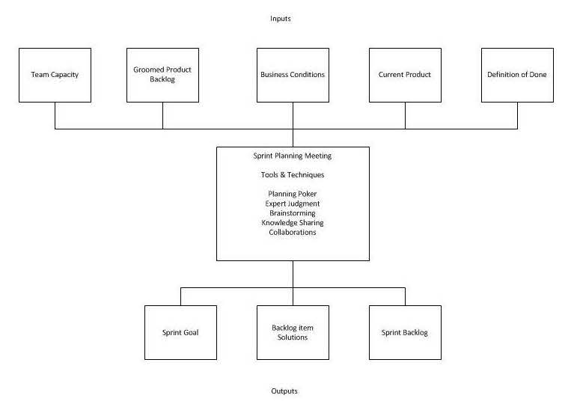
Sprint Planning
General Ideals:
Couple hours for 2 week Sprint, done at start of Sprint
Product Owner (basically the interface to business) has backlog of enough work to plan for sprint ready to discuss.
All Stories already estimated during prior story time.
Figure out workload based on estimates and team capacity (e.g., vacation, other work impediments).
Pull in enough stories from backlog to fill Sprint Workload.
One Reality:
Multiple hours on different days
Product Owner (basically the interface to business) has some backlog ready to discuss.
Not all stories yet pointed.
Figure out workload based on estimates and team capacity (e.g., vacation, other work impediments)
Pull in stories from backlog, and then realize we don’t have enough estimated, so we end up with impromptu Story Time
References:
https://www.scrumalliance.org/community/articles/2014/september/ittos-of-agile-scrum-ceremonies
https://www.atlassian.com/agile/ceremonies
https://switchingtoscrum.com

Slide 4
Story Time (unfortunately, does not involve cocoa and marshmallows)
General Ideals
Product Owner Presents work back logs items and tells a “story” of what is involved with that item
Developers and other team members (e.g., QA) ask questions to get clarity.
Discussion happens upon how problem might be addressed technically and what would be involved in doing the work
“Story” is created or flushed out in more detail.
Each Story given an estimate as to how much work (often through a modified Fibonacci Sequence with units of 1,2,3,5,8,13, and too big, or T-Shirt Sizes, or something similar), discussion happens to move points up and down and eventually an agreed upon value is decided.
If story is pointed too high, then story is broken down into two (or more) smaller stories.
One Reality
Product Owner Presents work back logs items.
The story telling is interactive between knowledgeable Developer(s), SA(s), and/or Product Owner, as well as discussion upon how problem might be addressed technically and what would be involved in doing the work.
No one else says anything, without prompting. ☹
“Story” is created or flushed out.
Each item estimated at 5 or 8 units no matter what the work item actually consists of, and then the real discussion happens between everyone else as senior people ask why a simple story is 8 points of work or really complicated one is only 5 points. At this point people then start to do the steps that should have happened before the pointing. (In case it is not obvious…this is a presenter’s serious pet peeve…)
Story is then pointed again, and a more realistic number is agreed upon.
If story is pointed too high Story should then be broken down into two (or more) smaller stories.

Slide 5
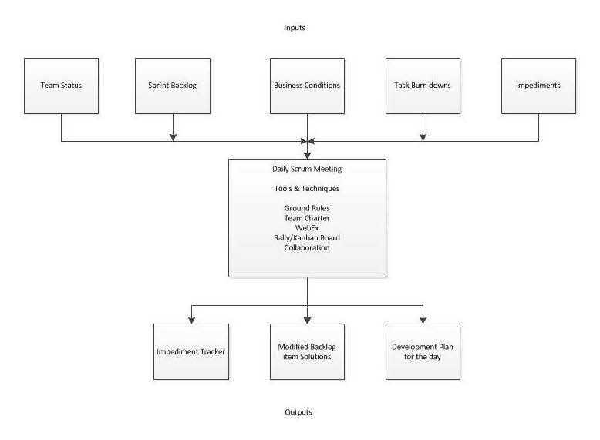
Stand up
General Ideals:
Have an actual physical “Stand up” meeting in your shared workspace to discuss current sprint
Each Team Member Verbally States:
What I worked on yesterday
What I am doing today
Any blocking items, preventing task (task is work item in story) completion.
One Reality:
Have a Lync (or Skype) meeting as team is very distributed around world.
A rotating team member “Walks the Wall of Stories”, discovering from team
What was worked on yesterday by who
Who is working on what today
What is Blocking items.
Making sure everyone is doing “something”

Slide 6
Collaboration Time
General Ideals:
Team is all in collocated space, where they can easily interact with each other.
Team dedicates blocks of time where other meetings are not allowed, and everyone is available to facilitate discussion and team problem solving.
One Reality
Have teams spanning 4 US/Mexican time zones plus Indian time zone (about 14 hours).
Make Virtual Collaboration with open phone line and open Lync (Skype) session.
People move in and out of phone and Lync session depending upon their time zone, and other meetings as the rest of company does not respect collaboration boundaries.

Slide 7
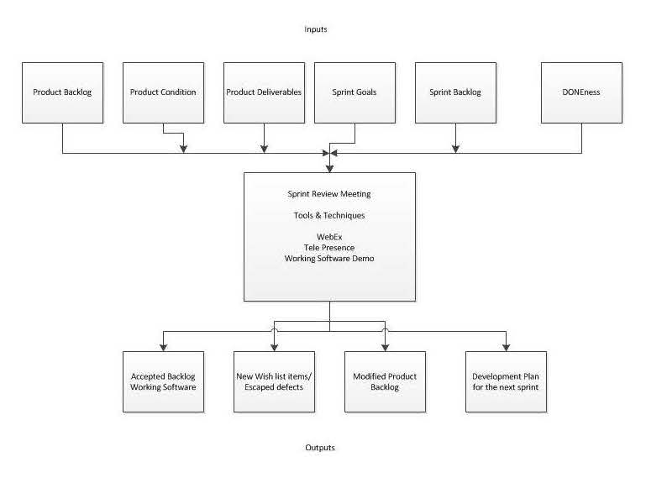
Sprint Review Meeting
General Ideals:
60 Minute or less meeting with entire team and stakeholders at end of Sprint
Review with Stakeholders on what was (was not) accomplished during Sprint.
Receive immediate feedback (hopefully positive), and quickly know if issues.
One Reality:
This one matches general ideals ☺
60 Minute or less meeting with entire team and stakeholders at end of Sprint
Review with Stakeholders on what was (was not) accomplished during Sprint.
Receive immediate feedback (hopefully positive), and quickly know if issues.

Slide 8
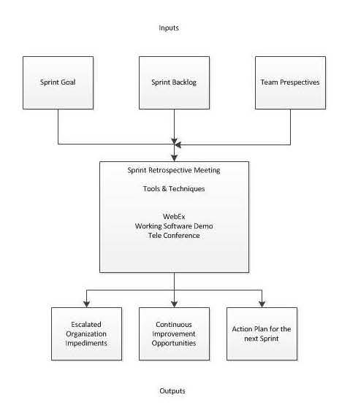
Retrospective
General Ideals:
Short 60 minute or less meeting with entire team at very tail end of Sprint.
Figure out what went well and what didn’t.
Take what you find in retrospective and apply it to your next or future sprint as applicable.
One Reality:
Short 60 minute or less meeting with entire team at very tail end of Sprint.
15 minutes of humor and joking to blow off steam from Sprint.
Figure out what went well and what didn’t.
Occasionally take what you find in retrospective and apply it to your next or future sprint as applicable (i.e., all to often retrospective ideas are forgotten in the retro document created).

